Slide 1
FBARC:
I/O Asymmetry-Aware Buffer Replacement Strategy
P. Dubs⁺, I. Petrov*, R. Gottstein⁺, A. Buchmann⁺
⁺Databases and Distributed Systems Group,
Technische Universität Darmstadt
*Data Management Lab,
Reutlingen University

Slide 2
Buffer Management on Modern Storage
Replacement strategies are optimized for traditional hardware
  Maximize Hitrate – primary criterion
    Temporal Locality | recency, frequency
    Reduce Access Gap
    Ignore Eviction costs
    Sufficient for traditional symmetric storage
New Storage Technologies
  Read/Write Asymmetry Issues
  Endurance Issues
  Performance
Eviction costs – performance penalty
  Expensive random writes
  Tradeoff between hitrate and eviction costs → lower overall performance
CPU Cache
(L1, L2, L3)
2ns
10ns
NVRAM
- PCM
read
RAM
100ns
write
1μs
10μs
Access Gap
Flash
read
25μs
80μs
Access Gap
write
500μs
800μs
HDD
5ms
Asymmetric,
Endurance
Symmetric
Notes:
Traditional buffer management strategies would utilize temporal locality of page accesses to increase the probability of locating the requested pages in the buffer (hit-rate) and minimize expensive disk accesses. Such strategies utilize two criteria to select victim pages to be evicted from the buffer once new ones are requested: recency and frequency. Since the traditional technologies exhibit symmetric performance (i.e. reads are as fast as writes), maximizing the hit-rate thus minimizing disk accesses of whatever type is a suffi- ciently general, single design criterion.

Slide 3
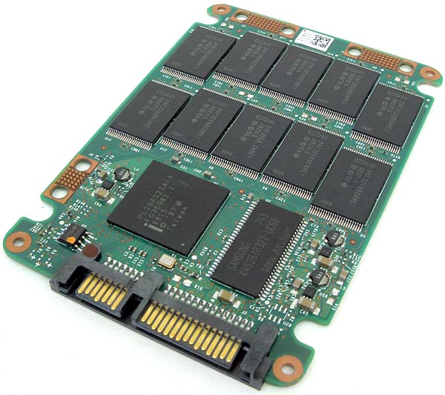
Example: LRU
Access Trace:
  R425, R246, R938, W246, R909, W938, R325, R909, R678, R913, R75
Fetch: 160µs
LRU Stack
Evicted
75
913
678
909
325
938
246
425
500µs
500µs
0µs
Evict
Total Read cost: 7x160µs = 1120µs
Total Write cost: 2x500µs + 2x160µs = 1320µs
Eviction costs outweigh fetch costs! (with 2 out of 9 requests!)
Notes:
LRU concentrates on recency and frequency
I/O Asymmetry can not be addressed by those alone
Page state affects eviction costs
Eviction of a dirty page may be as expensive as several cache misses
Eviction of N dirty pages may be as expensive as eviction of a single dirty page

Slide 4
Takeaway Message…
Design tradeoff:
  Trade hitrate and computational intensiveness for
  lower eviction costs to minimize the overall performance penalty
  In line with present hardware trends
Asymmetry considered first-class criterion besides hitrate!
  Spatial locality to address write-aspects of asymmetry
  Use semi-sequential writes and grid clustering
We propose FBARC:
  Based on ARC
  Write-efficient and endurance-aware
  High hitrate
  Computationally efficient – static grid clustering
  Workload adaptive
  Scan-resistant

Slide 5


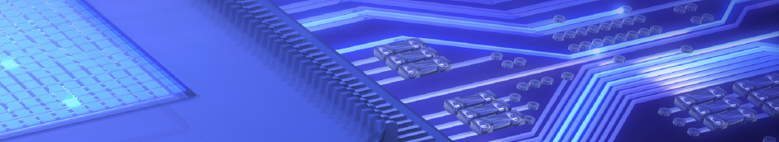
FBARC

Slide 6
ARC and FBARC
ARC
  2 aspects of temporal locality
  LRU organized lists
  Buffered pages held in T-Lists
  Metadata of evicted pages in B-Lists
FBARC
  Adds L3 to support spatial locality
  T3 organized for clustering
  B3 still LRU organized

Slide 7
FBARC Example
New pages enter T1

Slide 8
FBARC Example
New pages enter T1, until the cache is full

Slide 9
FBARC Example
When a Page in T1 or T3 is accessed again it moves to T2

Slide 10
FBARC Example
Marking a page as dirty moves it to the MRU position of T₂
  Forget “blind writes” for a second

Slide 11
FBARC Example
When a new page is requested and there is no free cache, a page has to be evicted
Clean pages can be directly evicted, and their metadata can be directly added to the corresponding B-List

Slide 12
FBARC Example
When a new page is requested and there is no free cache, a page has to be evicted
If a dirty page is chosen for eviction, it will be moved to T3, and another round of victim chosing will begin

Slide 13
FBARC Example
When a new page is requested and there is no free cache, a page has to be evicted
If T3 is chosen to supply an eviction victim, a cluster of pages will be chosen
  Select cluster with lowest score
  Reduce score for all clusters on each cluster eviction
  Increase score for a cluster when a new page enters, or an old page leaves for T2
FBARC: utilizes spatial locality
Notes:
Formation
Assign Cluster ID to Page based on page address and cluster size
Selection
Select cluster with lowest score
Reduce score for all clusters on each cluster eviction
Increase score for a cluster when a new page joins, or an old page leaves for T2

Slide 14
FBARC Example
When a new page is requested and there is no free cache, a page has to be evicted
If T3 is chosen to supply an eviction victim, a cluster of pages will be chosen
They will be evicted in order and all at once
FBARC: utilizes semi-sequential writes

Slide 15
FBARC Example
When a new page is requested and it is already known in a B-List then it will trigger a rebalancing
And the page will go directly to T2
The target size for the corresponding T-List will rise
The target size for the other
T-Lists will shrink
-1
+1

Slide 16
Formation & Selection of Clusters
Formation
  Assign Cluster ID to Page based on page address and cluster size
Selection
  Select cluster with lowest score
  Reduce score for all clusters on each cluster eviction
  Increase score for a cluster when a new page joins, or an old page leaves for T2

Slide 17
Evaluation

Slide 18
Experimental Setup
Machine:
  Intel Code 2 Duo 3GHz
  4GB RAM
  SSD: Intel X25-E/64GB
  HDD: Hitachi HDS72161 SATA2/320GB
Software
  Linux (Kernel 2.6.41 + Systemtap)
  fio
  PostgreSQL v9.1.1
    24MB shared buffers

Slide 19
Evaluation
FBARC compared to: ARC, LRU, CFLRU, CFDC, FOR+
  Simulation Framework
  Different cache sizes: 1024, 2048, 4096 pages
  Different metrics: hitrate, CPU time, I/O time, combined
Real Workload Traces
  Workload: TPC-C (DBT2), TPC-H (DBT3), pgbench
    Trace B: pgBench: Scale Factor: 600
    Trace C: TPC-C (DBT2): 200 Warehouses → DBMS size: ca. 20GB
    Trace C_{d}: Delivery Tx, TPC-C 200 Warehouses → DBMS size: ca. 20GB
    Trace SR: Trace B, sequential parasites length of cache size
  PostgreSQL Buffer Manager
    Isolate the rest of DB functionality
    bufmgr.c → Methods: fetching | mark dirty

Slide 20
Strategy

Slide 21
Trace Characterization
Buffer of 4K pages: cache 70% all pgbench accesses, 50% all TPC-C accesses (40% of all writes), 85% TPC-H
Notes:
Trace B: Writes are uniformly random and equally distributed. Write intensive → Cannot be handled properly by clustering

Slide 22
Results: Hitrate
Trace B
  ARC:
  1024=89.9%
  2048=91.3%
  4096=92.3%
  FBARC:
  1024=88.4%
  2048=90.4%
  4096=92.1%
Trace C
  ARC:
  1024=78.6%
  2048=81.1%
  4096=83.2%
  FBARC:
  1024=77.7%
  2048=81.2%
  4096=83.8%
FBARC: Marginally lower hitrate than others. Outperforms ARC on Traces C, C_{d}

Slide 23
Results: I/O time
Trace B
  ARC:
  1024=168
  2048=158
  4096=149
  FBARC:
  1024=180
  2048=164
  4096=149
Trace C_{d}
  ARC:
  1024=537
  2048=486
  4096=487
  FBARC:
  1024=581
  2048=478
  4096=442
FBARC: I/O time improves with larger buffer sizes. Outperforms others on Traces C, C_{d}! Better Write rate.

Slide 24
Results: CPU time
Trace H
  ARC:
  1024=167
  2048=183
  4096=202
  FBARC:
  1024=188
  2048=195
  4096=213
Trace C_{d}
  ARC:
  1024=138
  2048=145
  4096=156
  FBARC:
  1024=293
  2048=334
  4096=317
FBARC: Stable computational intensiveness.
Complexity grows slower with the cache size.

Slide 25
Results: Overall time
Trace H
  ARC:
  1024=275
  2048=273
  4096=285
  FBARC:
  1024=278
  2048=279
  4096=292
Trace C_{d}
  ARC:
  1024=571
  2048=518
  4096=513
  FBARC:
  1024=607
  2048=495
  4096=456
FBARC: Outperforms others on Traces C, C_{d}!
Worst case: synchronous I/O, no parallelism.

Slide 26
Scan Resistance
Read:
  CFDC:
  128=80.01%
  256=83.2%
  2048=90.1%
  FBARC:
  128=87.9%
  256=90.4%
  2048=92.9%
Write:
  CFDC:
  128=76.2%
  256=80.3%
  2048=88.2%
  FBARC:
  128=88.3%
  256=90.4%
  2048=92.9%
FBARC: Excellent scan resistance due to ARC!
Bigger hitrate drops for smaller caches.
Notes:
Scan Resistance → Sequentialization
Anaytical wokloads (large seq scans) | Cache-Awareness
Write reduction on asymmetric media
OLTP Trace → out-of-range sequential parasites to pollute cache (n) → n further OLTP requests
The smaller the cache size the bigger the hitrate drop.
FBARC, like ARC, uses the recency list to filter out pages that are accessed only onces, and thus a sequential parasite can only pollute a relatively small part of the cache.
A sequential write parasite can flush the T3 list, it does not influence the hitrate in a significant way as these pages are not frequently accessed. Additionally it will buffer the write parasite and write it out sequentially.
FOR+ → not scan resistant. Uses additional information to keep Hot pages longer that others.
CFDC, CFLRU:
Read: lower hitrate penalties → banance Read/Write regions
Write: whole buffer cache poluted despite write clustering

Slide 27
Summary

Slide 28
Summary
Design tradeoff:
  Trade hitrate and computational intensiveness for
  lower eviction costs to minimize the overall performance penalty
Asymmetry considered first-class criterion besides hitrate!
  Use semi-sequential writes and grid clustering (Spatial locality)
FBARC:
  Write-efficient: up to 10% under TPC-C
  Comparatively High hitrate: 0% - 2% worse than LRU
  Computationally efficient: stable
    better than other clustering strategies
    static grid clustering
  Workload adaptive: yes
    inherited from ARC
  Scan-resistant: 10% better than others
    inherited from ARC

Slide 29

Thank you!
„People who are really serious about
software should make their own hardware„
Dr. Alan Kay, 2003 Turing Award Laureate

Slide 30
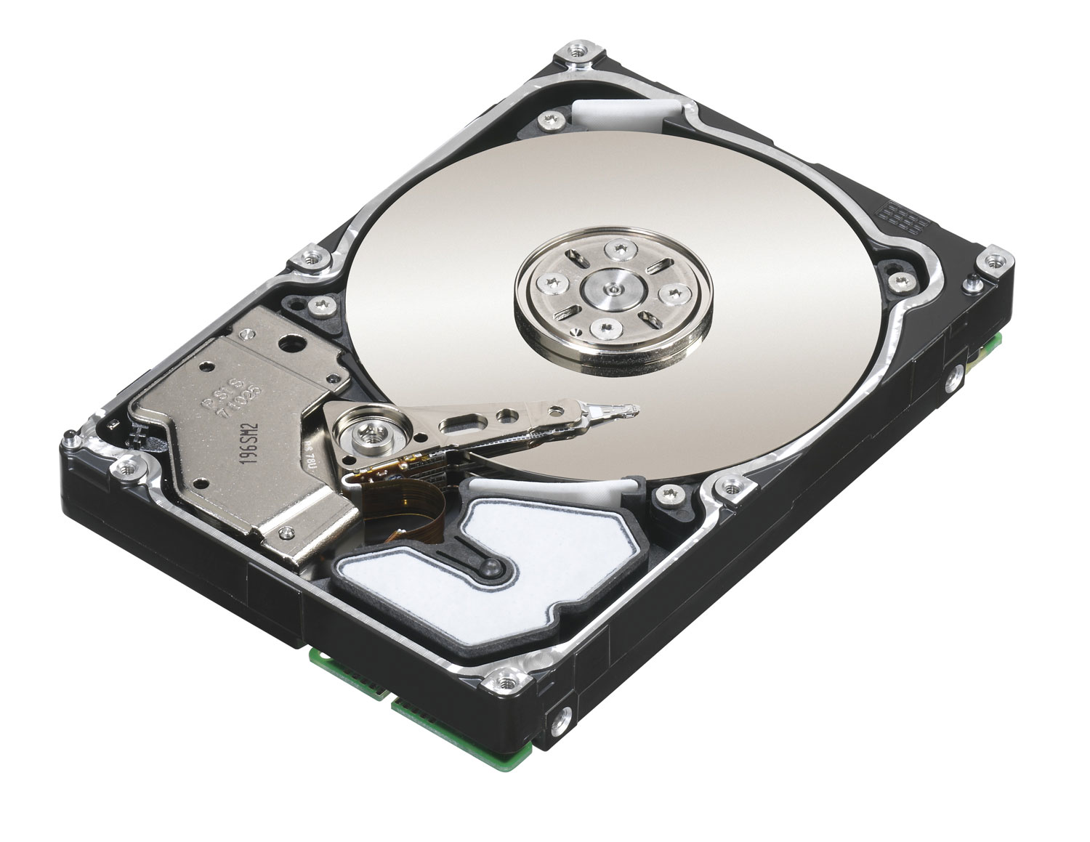
Read/Write Asymmetry

Slide 31
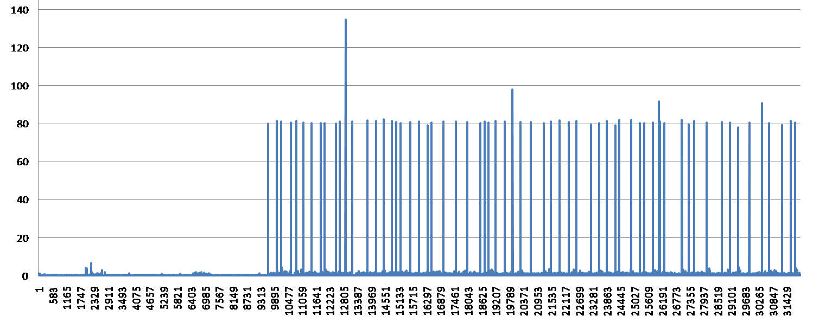
Cost of FTL, Backwards Compatibility
Unpredictable performance - background processes
Adverse performance impact - limited on-device resources
Redundant functionality - at different layers on the I/O path
Lack of information and control prevents complete utilization of physical characteristics of the NAND Flash
≈ 10 000, 4KB Req
≈ 40 MB
T_{a}
Notes:
Req. Size [KB] 4
Requests 10000 RW
1QD - Cache 3000
RW 1QD - No Cache 2000
Cache [KB] 8192
KB to Write 10K Req 40000
Cached Req 2048
Sec (Write to SSD Cache) 3.333333333
Sec (Write From SSD Cache) 5
Sec (Buffered) 1
Sec Remains 0.666666667 → Requests Outstanding 2000

Slide 32
Are we using hardware efficiently?
What does the future bring?
Large Main Memories
128 TB by 2022
Computing Power
1000 Core/CPU by 2022
Bandwidth
Memory: 2.5 TB/s
IO: 250 GB/s
Hardware Trends
[A. von Bechtolsheim]
Fast Persistent Storage
1TB Flash Chips by 2022
Non-Volatile Memories
512 TB by 2022
Andreas von Bechtolsheim. Technologies for Data- Intensive Computing. HTPS 2009
Notes:
Question: A.v.Bechtolsheim – ring a bell?
Multi-Core CPUs – parallelism (PostgreSQL – singlet rheaded)
Large Main Memories – But DB cannot benefit
Flash – But it is used like a disk
Asymetric

Slide 33
Data Management Lab
http://dblab.reutlingen-university.de
„People who are really serious about software should make their own hardware„
Dr. Alan Kay, 2003 Turing Award Laureate

