Slide 1
Transactions AND Analytics OLTP AND OLAP in Main Memory Database Systems HyPer ➔ one size fits all ... again
Alfons Kemper
Technische Universität München
Joint work with:
Thomas Neumann, Martina Albutiu, Florian Funke, Henrik Mühe

Slide 2
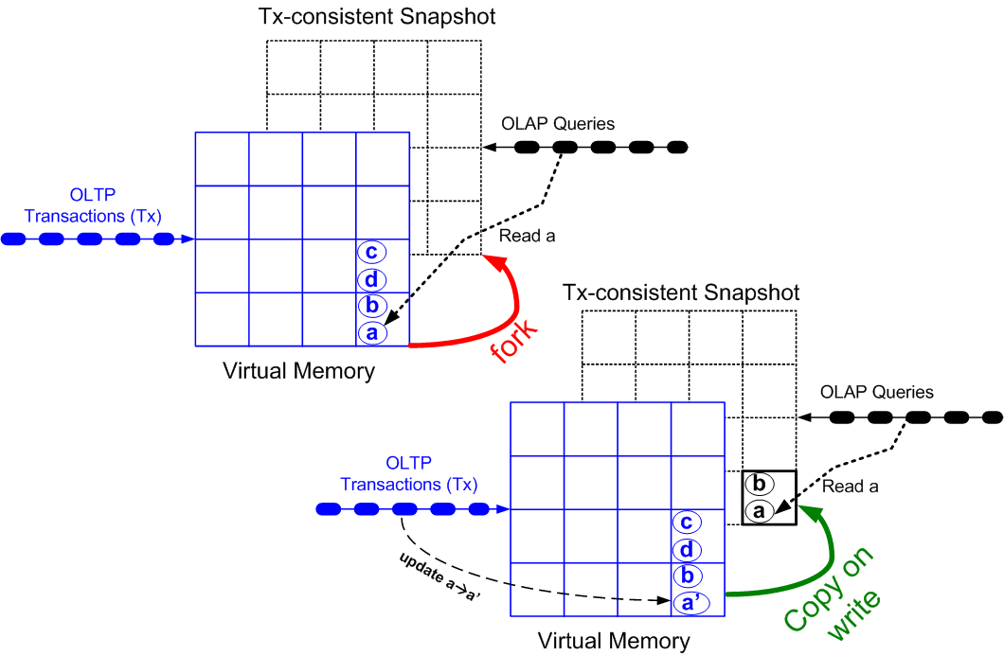
HyPer: Hybrid OLTP&OLAP Database System

Slide 3
HyPer: Hybrid OLTP&OLAP Database System

Slide 4
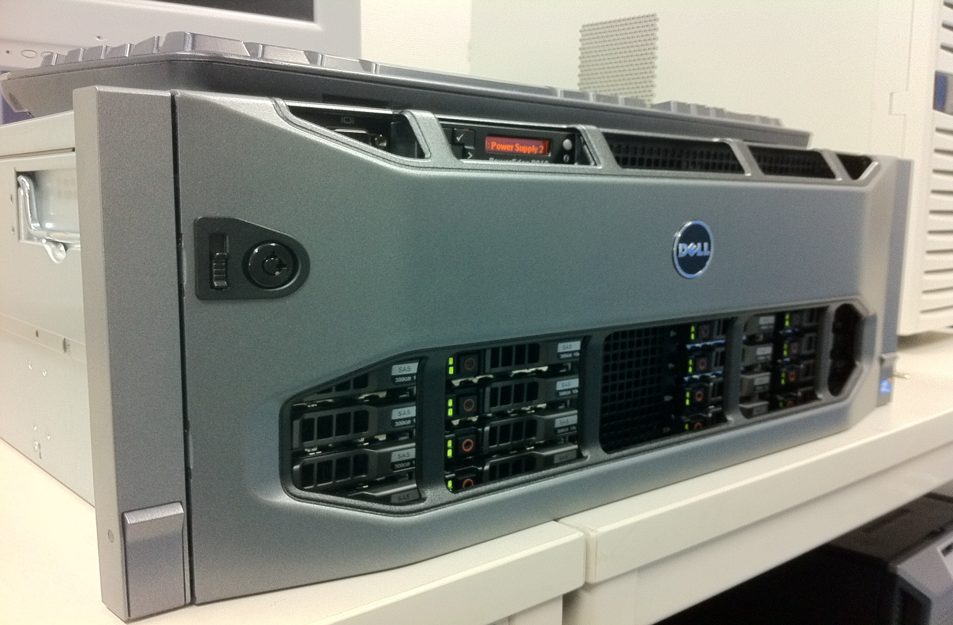
The Main Frame is strikes back

Slide 5
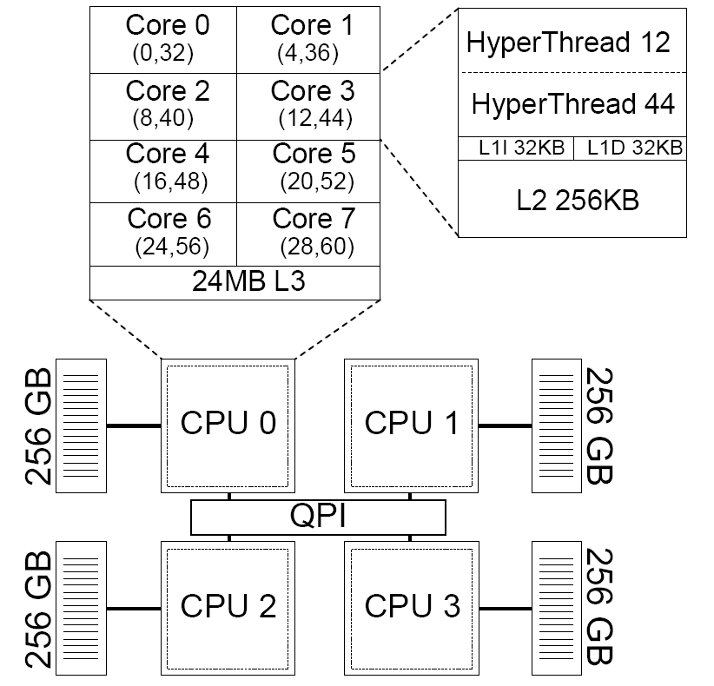
Hardware trends …
Increasing main memory
Can hold all transactional data of Amazon
Massive processing parallelism
Non-uniform Memory Access (NUMA)
Affordable: 40000 €
Our server:
4 CPUs
32 cores
1 TB RAM
4 NUMA partitions
Notes:
Today‘s hardware follows two trends: huge main memory capacities and highly parallel multi-core processing. A good example is our new server HyPer1. It has 4 CPUs with 8 physical cores each, which results in a total of 32 cores, and 1 TB of RAM which is divided into 4 NUMA partitions.

Slide 6
Details in this VLDB Conference
Compacting Transactional Data in Hybrid OLTP & OLAP Database. Florian Funke, Alfons Kemper, Thomas Neumann
Tuesday, 13:30 Session
Massively Parallel Sort-Merge Joins in (NUMA) Main Memory Multi-Core Database System. Martina-Cezara Albutiu, Alfons Kemper, Thomas Neumann
Wednesday, 16:00 Session

Slide 7
Compaction

Slide 8
The three NUMA commandments
C2
Thou shalt read thy neighbor‘s memory only sequentially -- let the prefetcher hide the remote access latency.
C3
Thou shalt not wait for thy neighbors -- don‘t use fine-grained latching or locking and avoid synchronization points of parallel threads.
C1
Thou shalt not write thy neighbor‘s memory randomly -- chunk the data, redistribute, and then sort/work on your data locally.
Notes:
From the microbenchmark conclusions we derive the following three rules or commandments for algorithms on modern hardware:
Instead of accessing remote memory randomly, data should be chunked, redistributed and then processed locally.
When remote memory is accessed this should happen only sequentially.
Synchronization between threads has to be avoided!

Slide 9
Basic idea of MPSM: Massively Parallel Multi-Core NUMA-affine Sort merge Join ➔ 160 mio records per second
C1: Work locally: sort
C3: Work independently: sort and merge join
C2: Access neighbor‘s data only sequentially
chunk R
R chunks
sort R chunks locally
MJ
MJ
MJ
MJ
merge join chunks
S chunks
sort S chunks locally
chunk S
Notes:
Then each worker sorts its local chunk of R and S which corresponds to commandment one. Finally, each thread merge joins its sorted run of input R with all sorted runs of input S. Thereby, the local R run is read several times which is not critical as it is the smaller one and it is in local memory. We call R the private input as each thread only works on its local R chunk. S is the public input and which each thread reads completely. There is no synchronization during the sort phases or during the merge join phase, so that commandment three is fulfilled. Further, during merge join remote memory is accessed only sequentially, so that commandment two is also met.

Slide 10
Multi-Tenency: Shared Machine up to 128 HyPer Database Instances
TPC-C
TPC-C
TPC-C
TPC-C
1
2
3
128

Slide 11
Shared Machine / 64 HyPer Instances

Slide 12
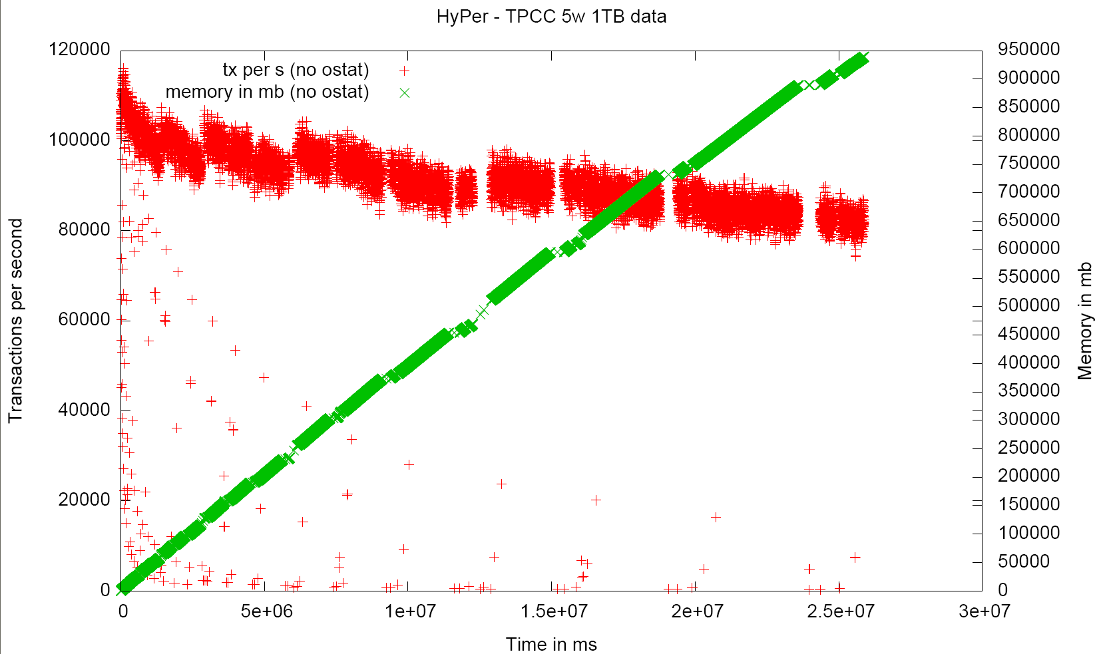
Scale up: Sustained Performance of a Single HyPer Instance

Slide 13
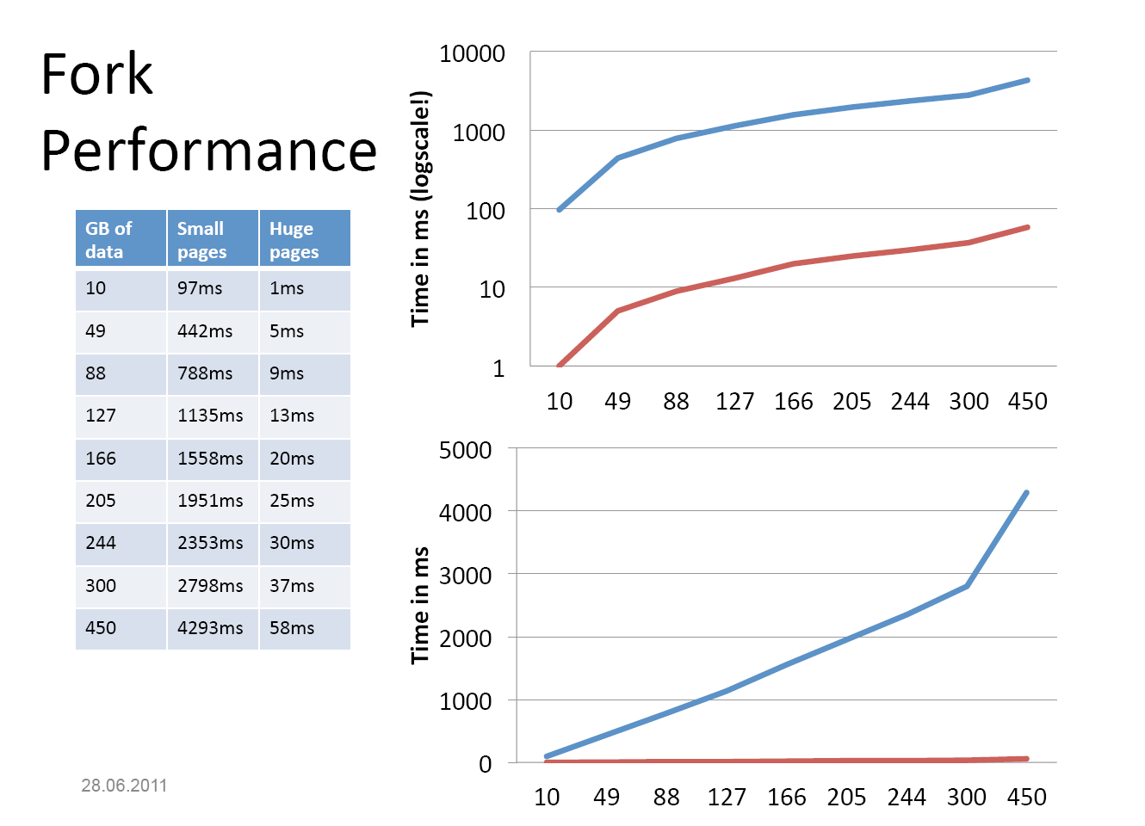
Fork Performance

Slide 14
Snapshotting via fork-ing: Details

Slide 15
Snapshot Maintenance: copy on write

Slide 16
Specs of the Machine (1 TB RAM, 32 Cores, 40 K €)
Ca 40000 Euros (slightly discounted price)
16 146GB SAS 6Gbit/s 10k 2,5 inch Discs Hot Plug
1 PERC H700 Integrated RAID Controller, 512MB Cache
4x Intel Xeon X7560 Processors (2,26GHz, 24MB Cache, 6,40GT/s QPI, Turbo, HT, 8C), 1066MHz Max. main memory (➔32 „real“ cores / 64 hardware contexts)
1TB Memory for 4CPU (64x16GB Quad Rank RDIMMs) 1066MHz, 8 Memory Risers Included
1 Single Two-Port 5709 Gigabit Ethernet with Single Two-Port 57711 10Gb SFP+ Controllers
1 PE R910 Rack Bezel
1 C2 - R0 for PERC H700, Min. 1 Max. 4/16 Drives, Max. number depends on backplane
4 0.6M Rack Power Cord C13/C14 12A
1 High Output Power Supply (2+2 PSU) 1100W, Redundant Full-Power Configuration
1 Ready Rack Gleitschienen
1 16X DVD+/-RW Drive SATA for Win2K8 R2
1 iDRAC6 Enterprise

